Slide 1
WeCare Ngo
Presented By:
Yu Wu
Juili Potdar

Slide 2
Contents
1.
Introduction
4.
Accessibility
Motivation & Goals
2.
5.
Demo
Conclusion and Future Scope
3.
UX Process
6.

Slide 3

Introduction
WeCare is an NGO website aimed to help children affected by poverty.
We aim to design a usable interface for the NGO.
WeCare provides a platform for users to donate for the charity and also sponsor children to help them in need.

Slide 4
Motivation & Goals
Charity organizations are involved in giving back to the society.
The main motivation is creation of a usable platform for a children’s charity where users can also sponsor children.
Creation of an easy donation payment process for the charity.
Sponsor a child function through which users can fund children to help them.
Write a letter functionality to help the users connect with their sponsored children.
Make users develop trust towards organization.

Slide 5


UX Process Survey to Understand User Needs
We conducted survey to assess user needs.
Survey consisted of 10 questions.
Number of respondents - 18

Slide 6
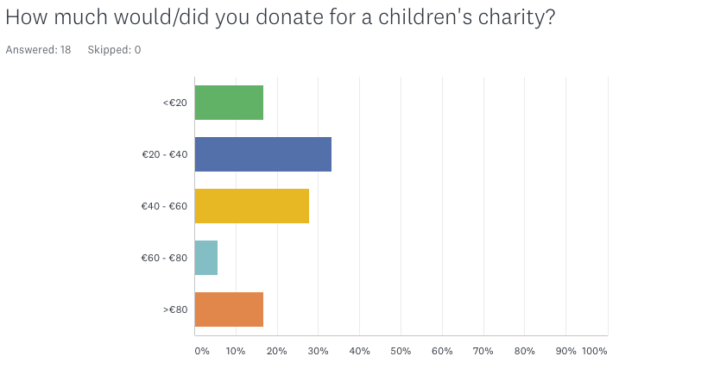
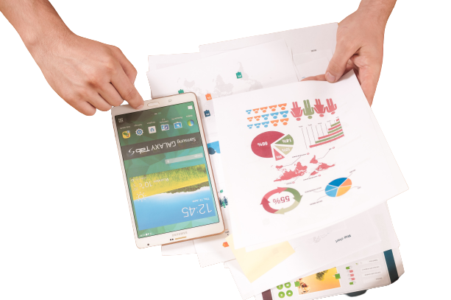
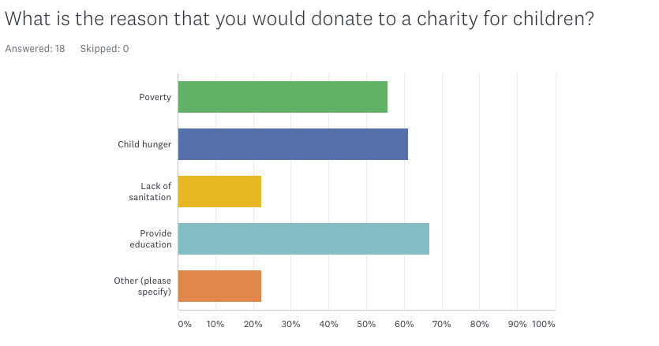
UX Process Survey Analysis

Slide 7
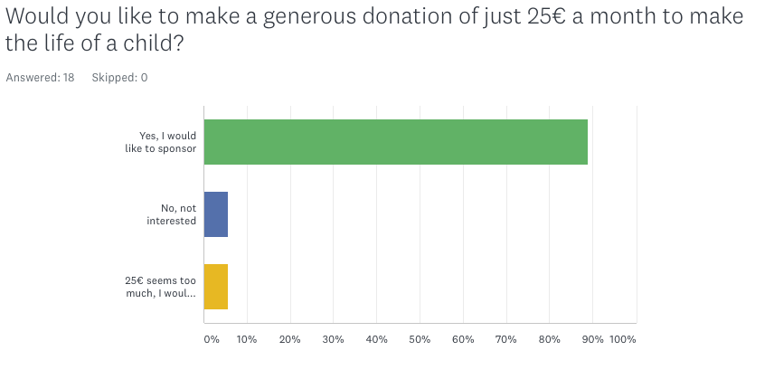
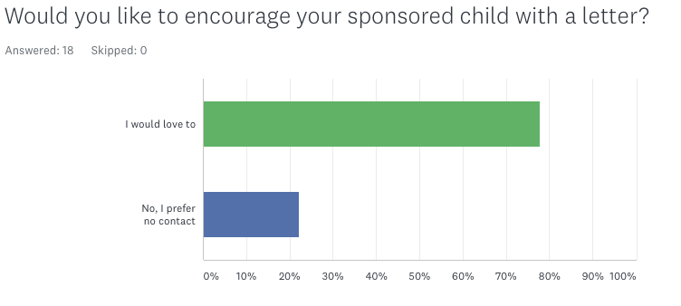
UX Process Survey Analysis

Slide 8
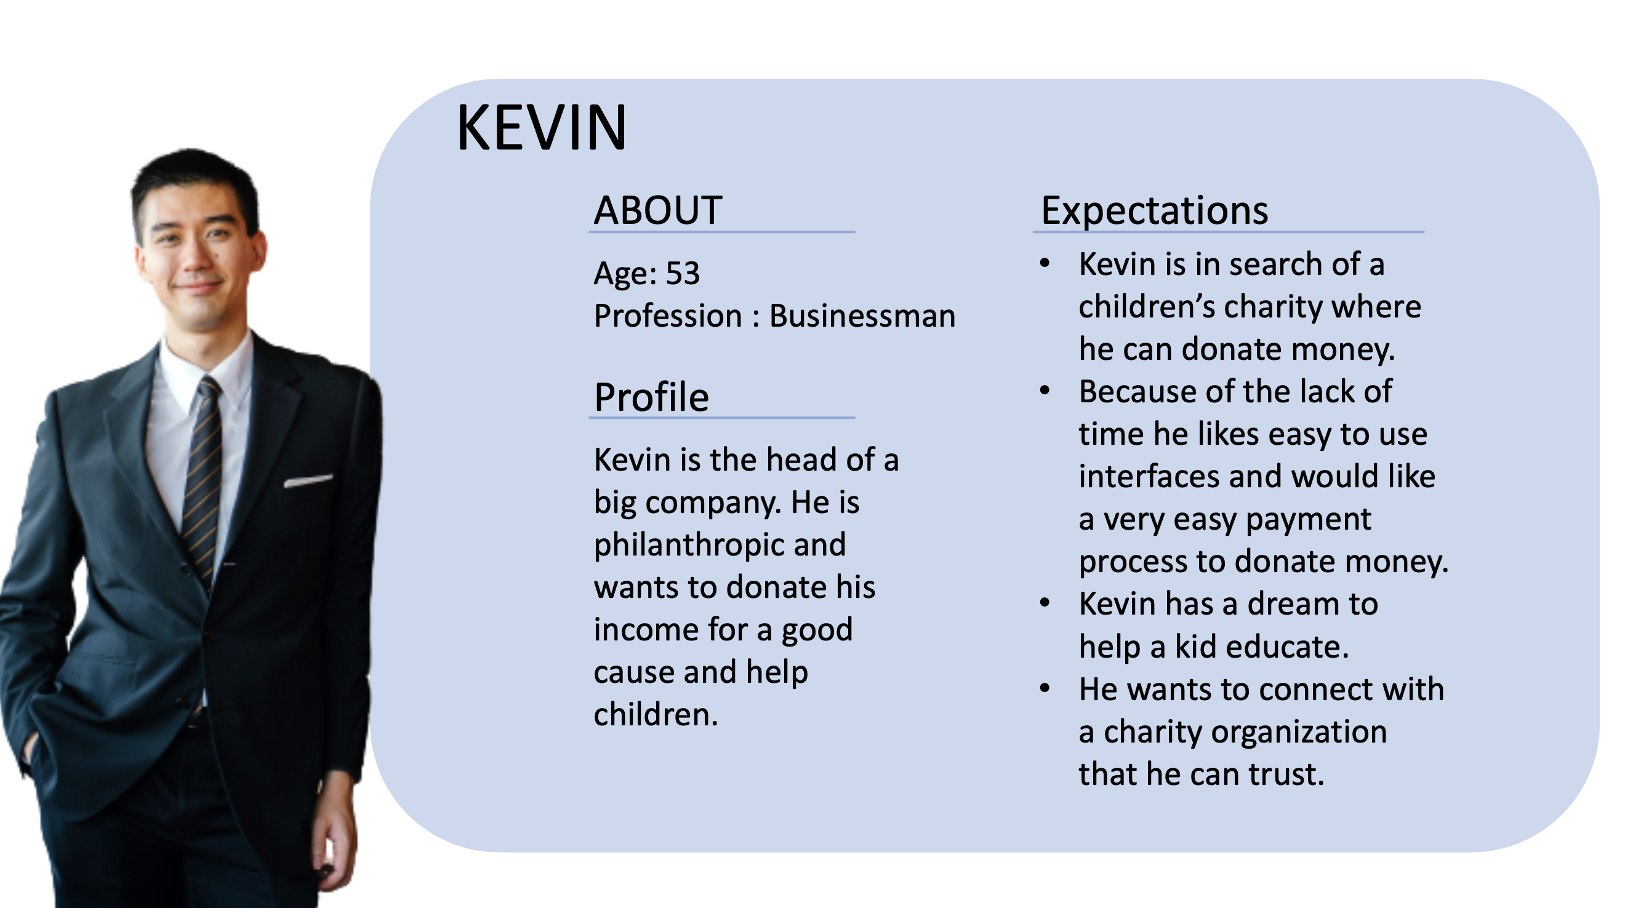
UX Process Persona - Kevin

Slide 9
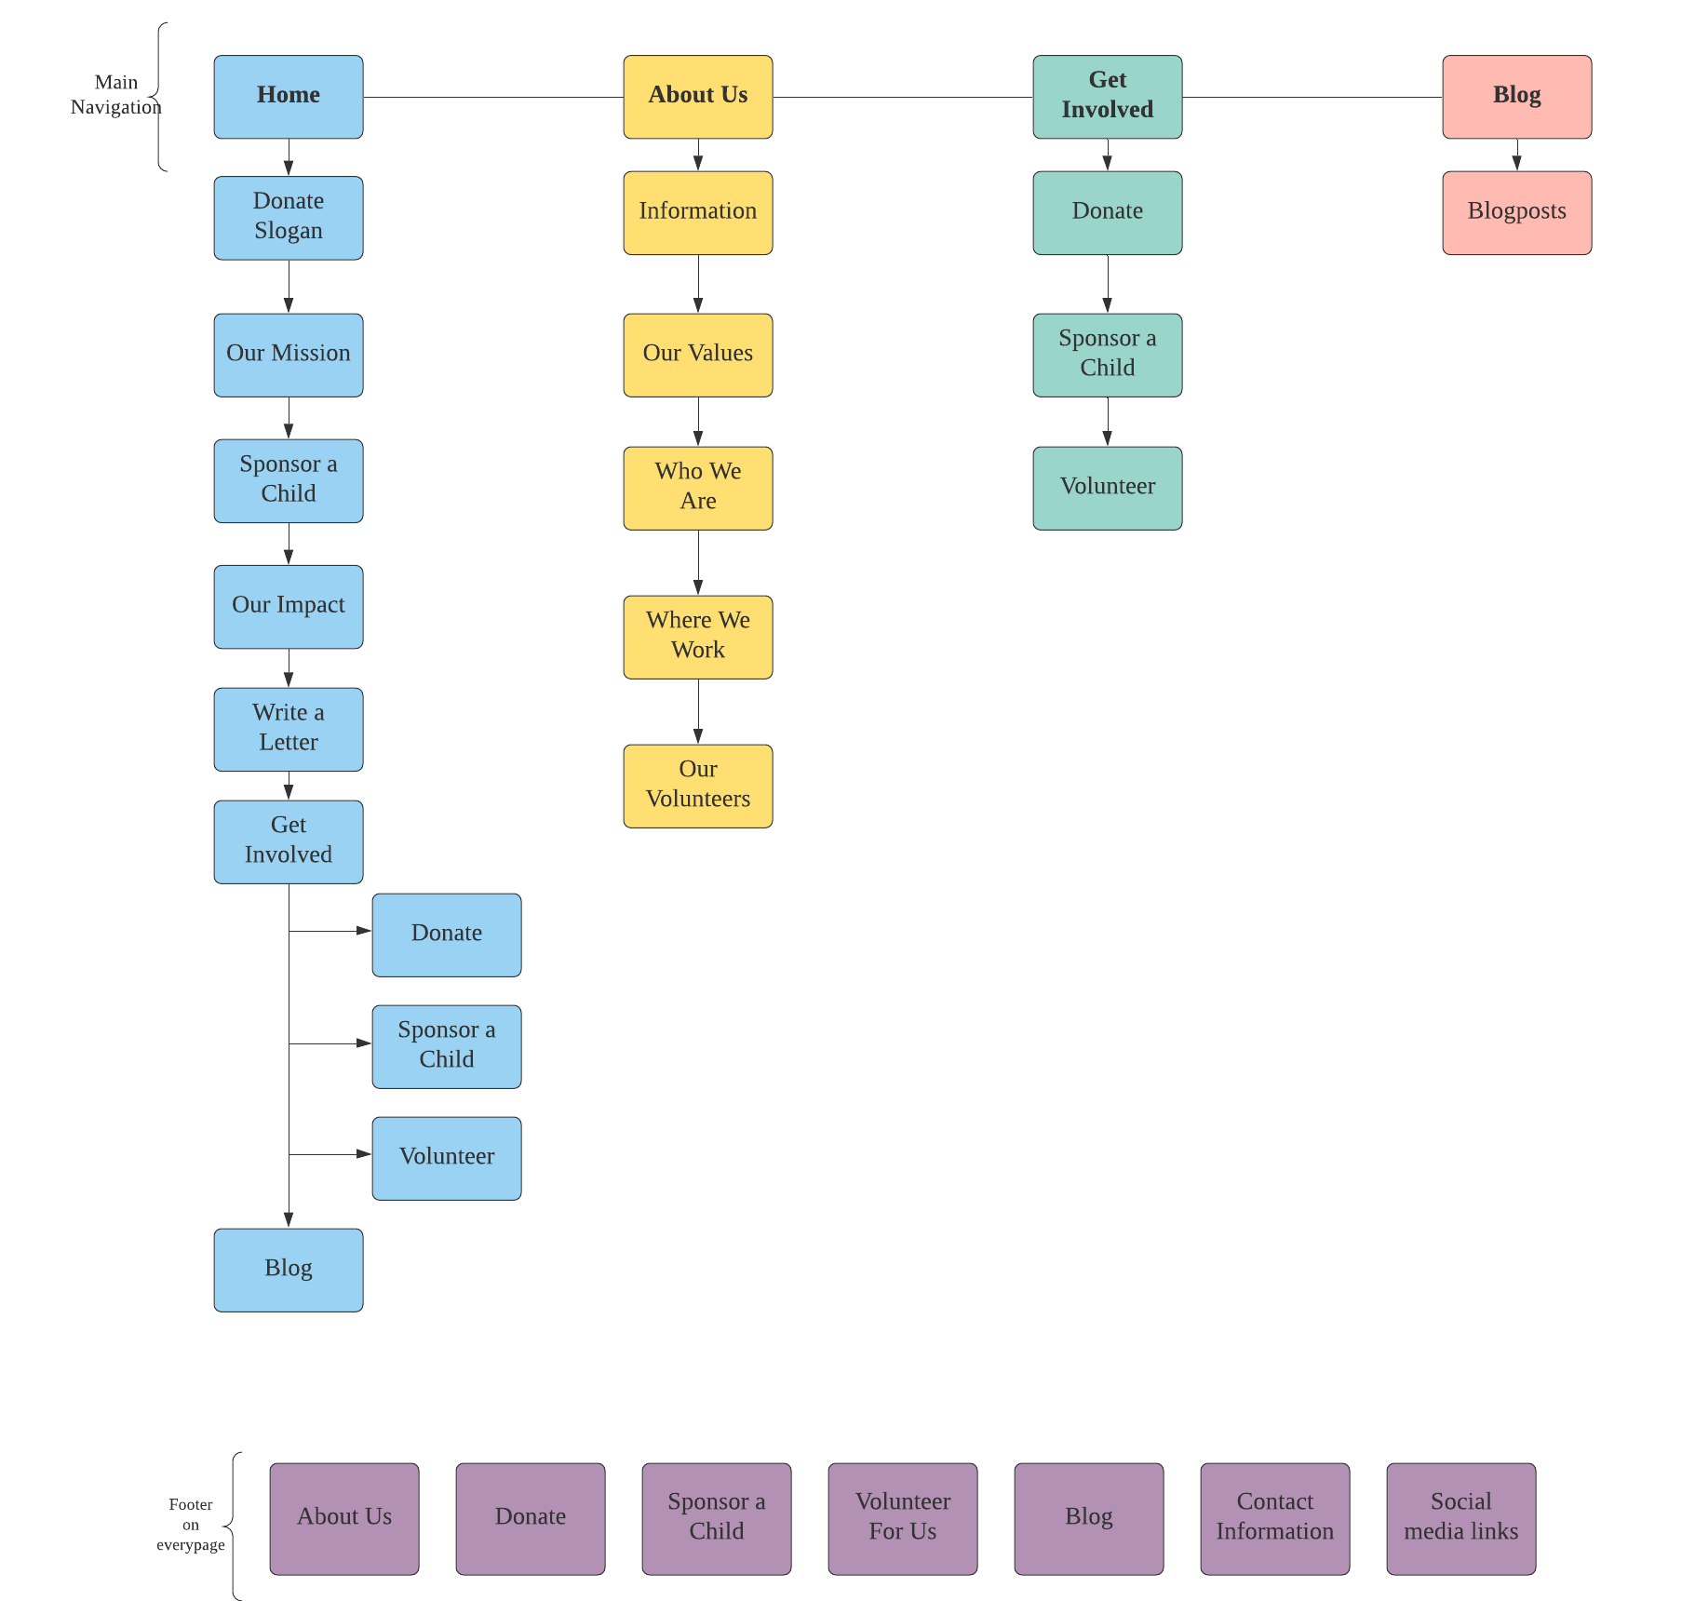
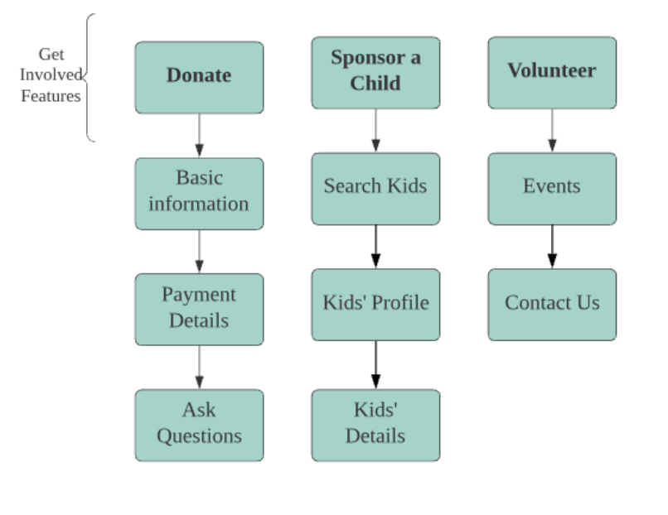
UX Process Information Architecture

Slide 10
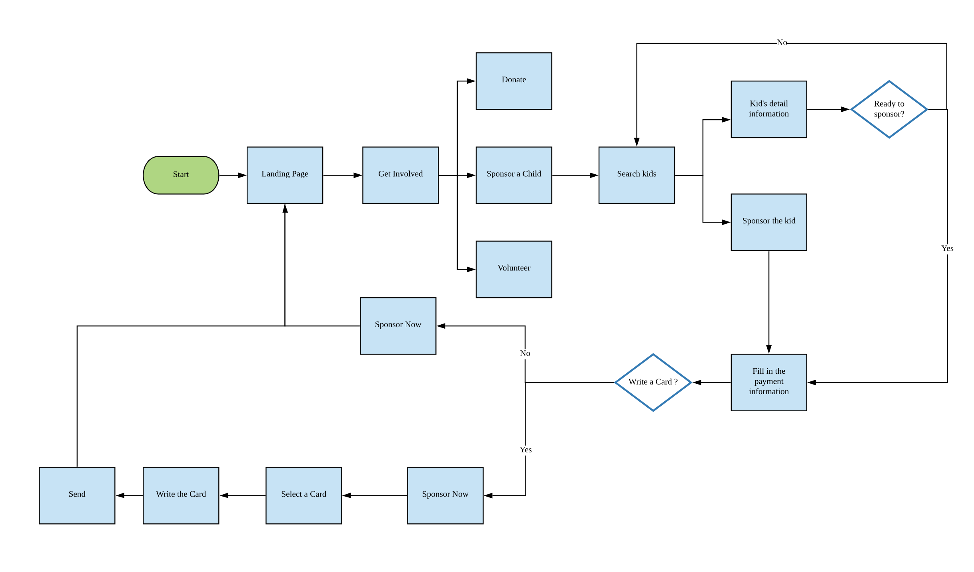
UX Process User Flow

Slide 11
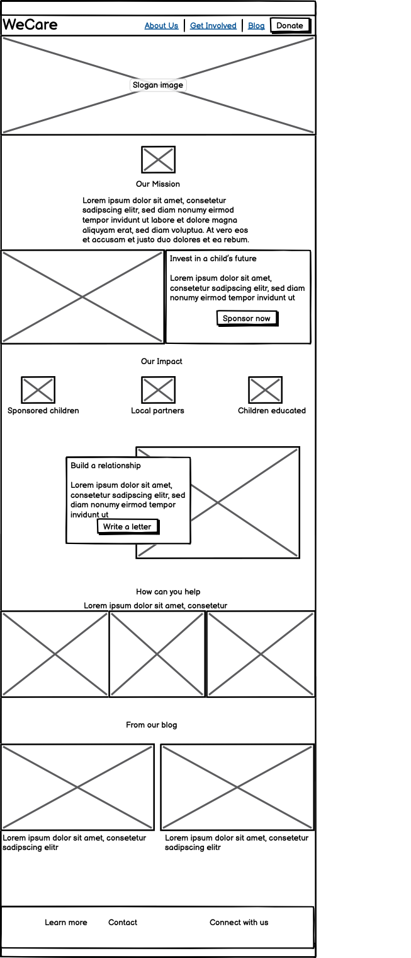
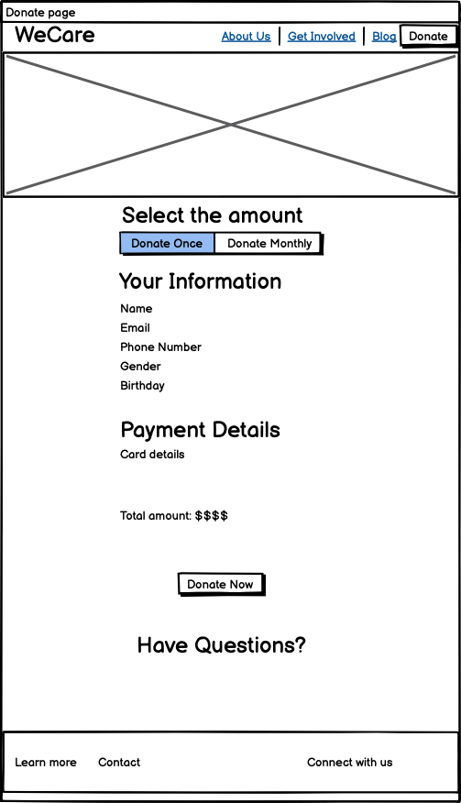

UX Process Wireframe

Slide 12
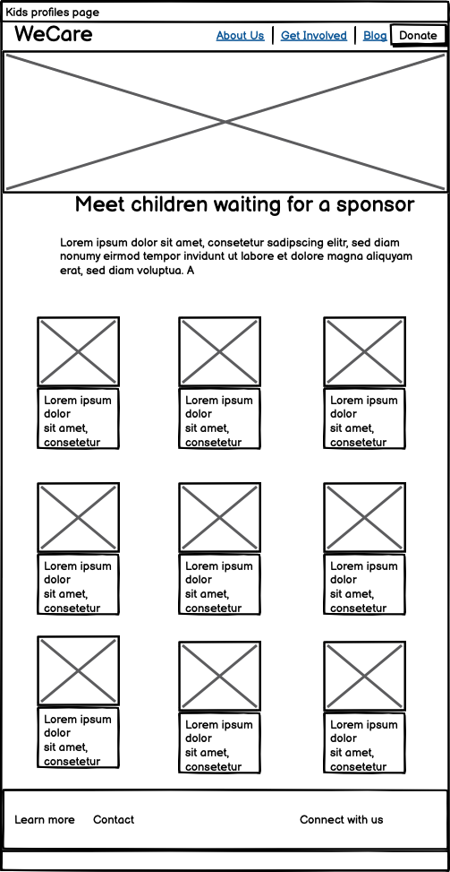
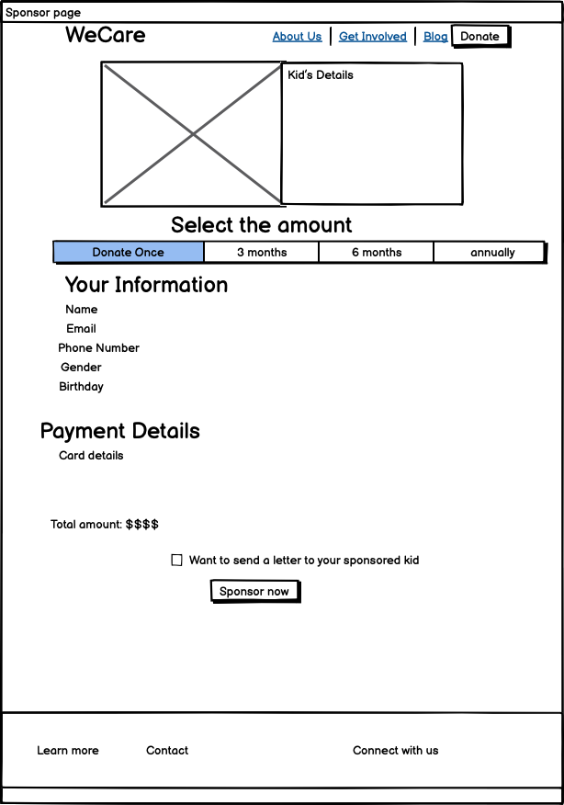
UX Process Wireframe

Slide 13
Accessibility
Focus
Focus on input textboxes when user types
Alt Text
Alternate texts for images
Aria
Use of aria-label
Tab
Tab key to navigate to inputs and buttons

Slide 14
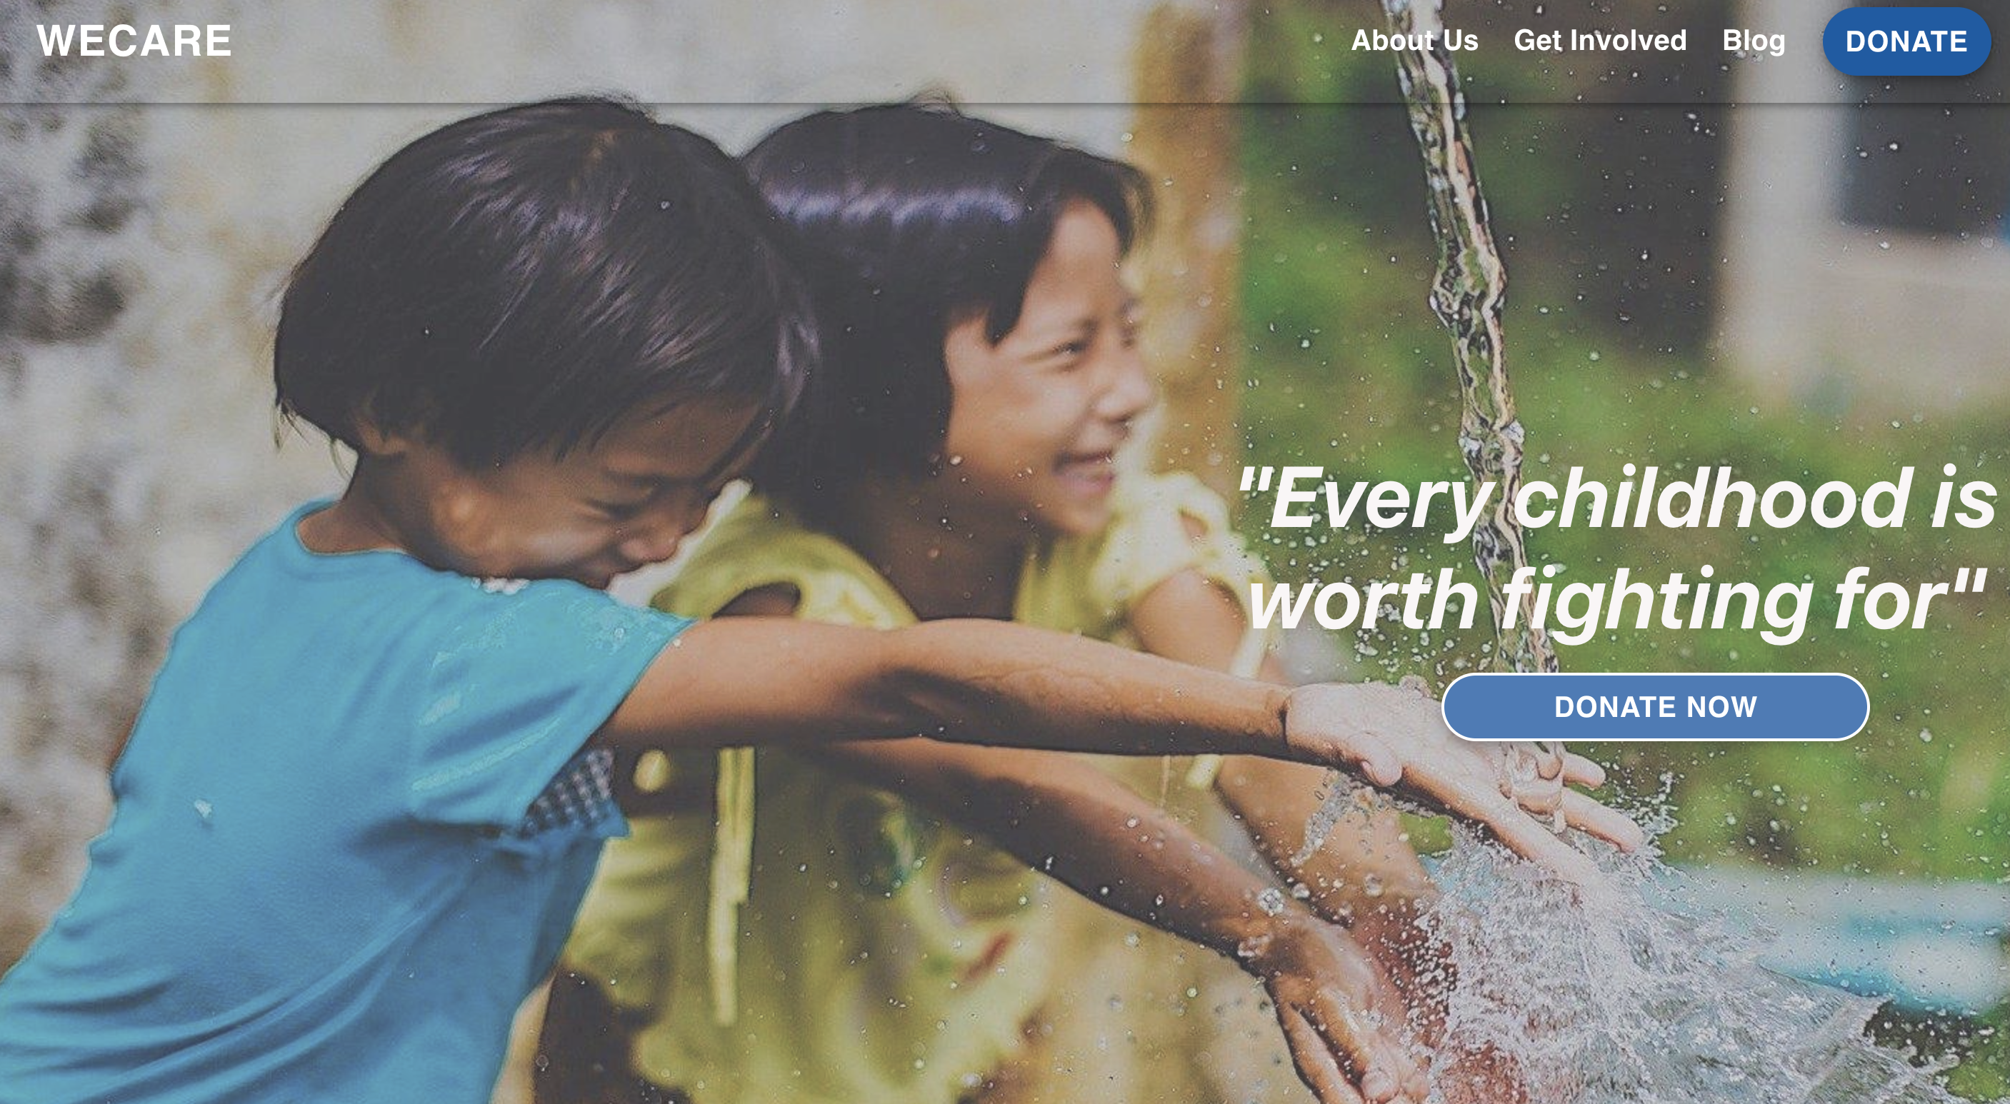
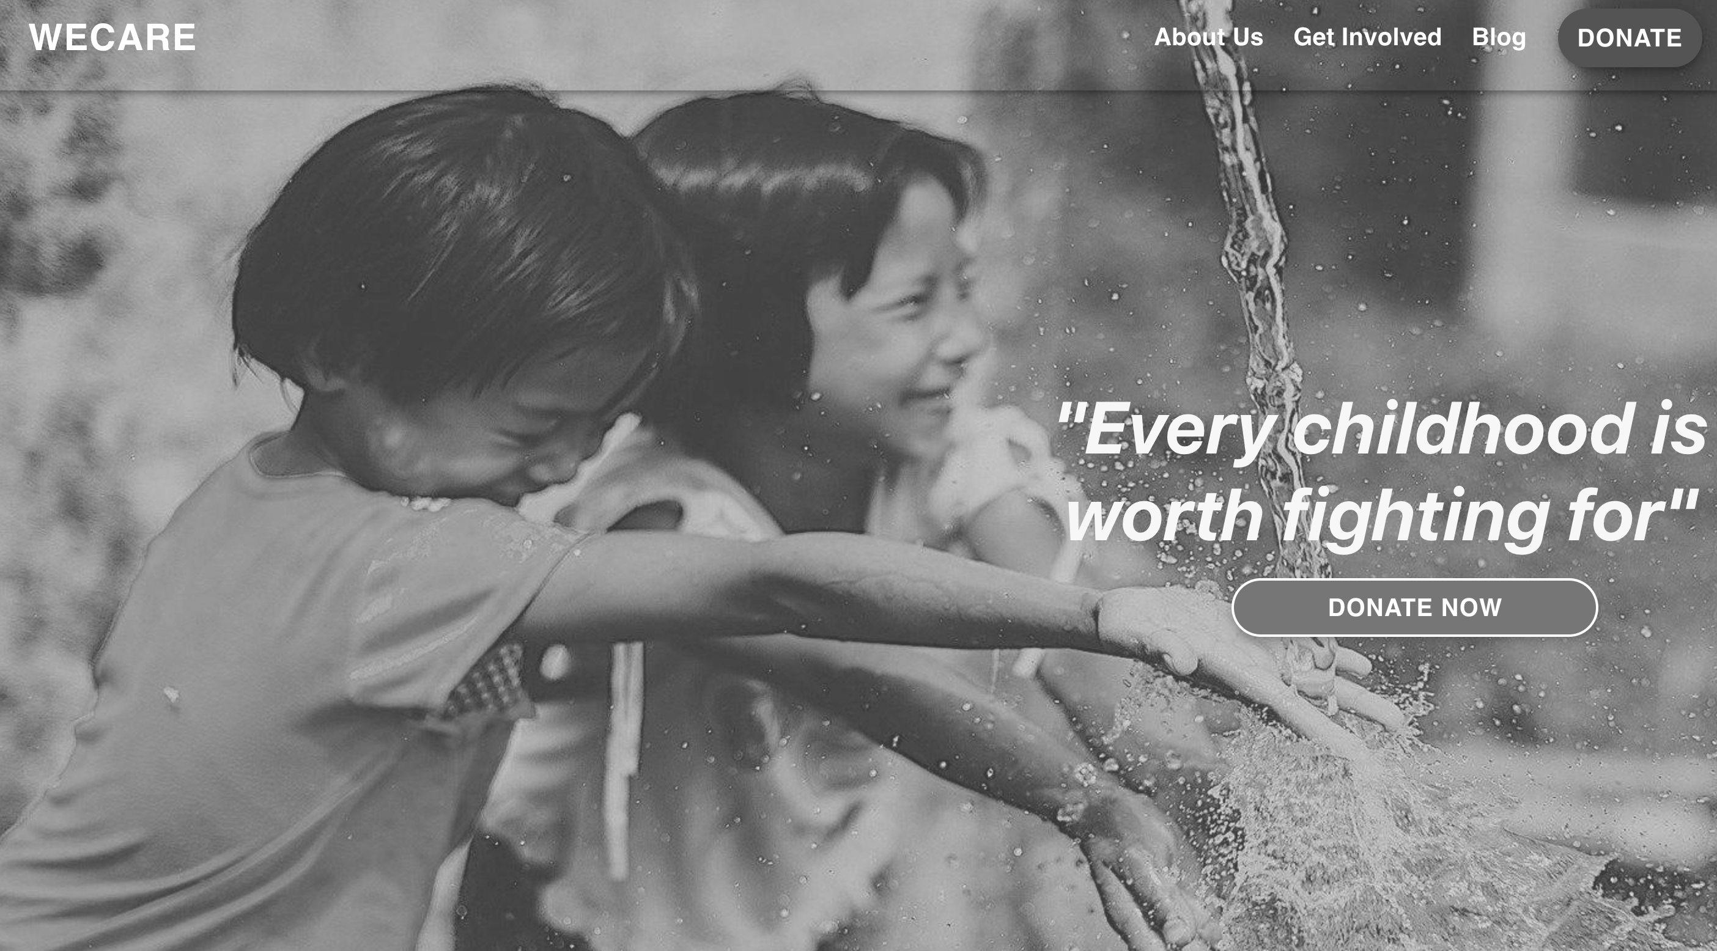
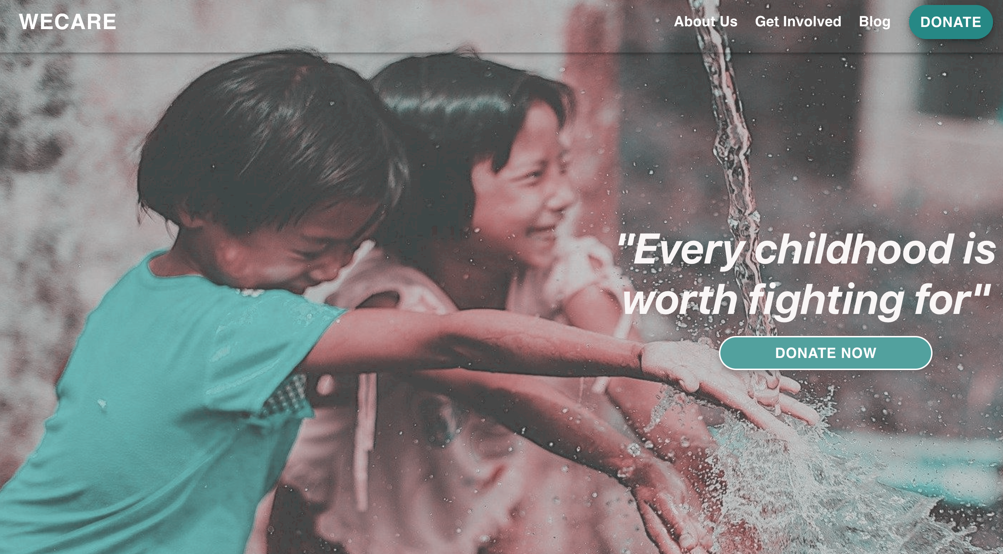
Accessibility Color Blindness Tests
Tool Used : A11Y Color Blindness Empathy Test
Normal
Grayscale
Tritanopia

Slide 15
Demo
Adobe Xd prototype
React js implementation

Slide 16
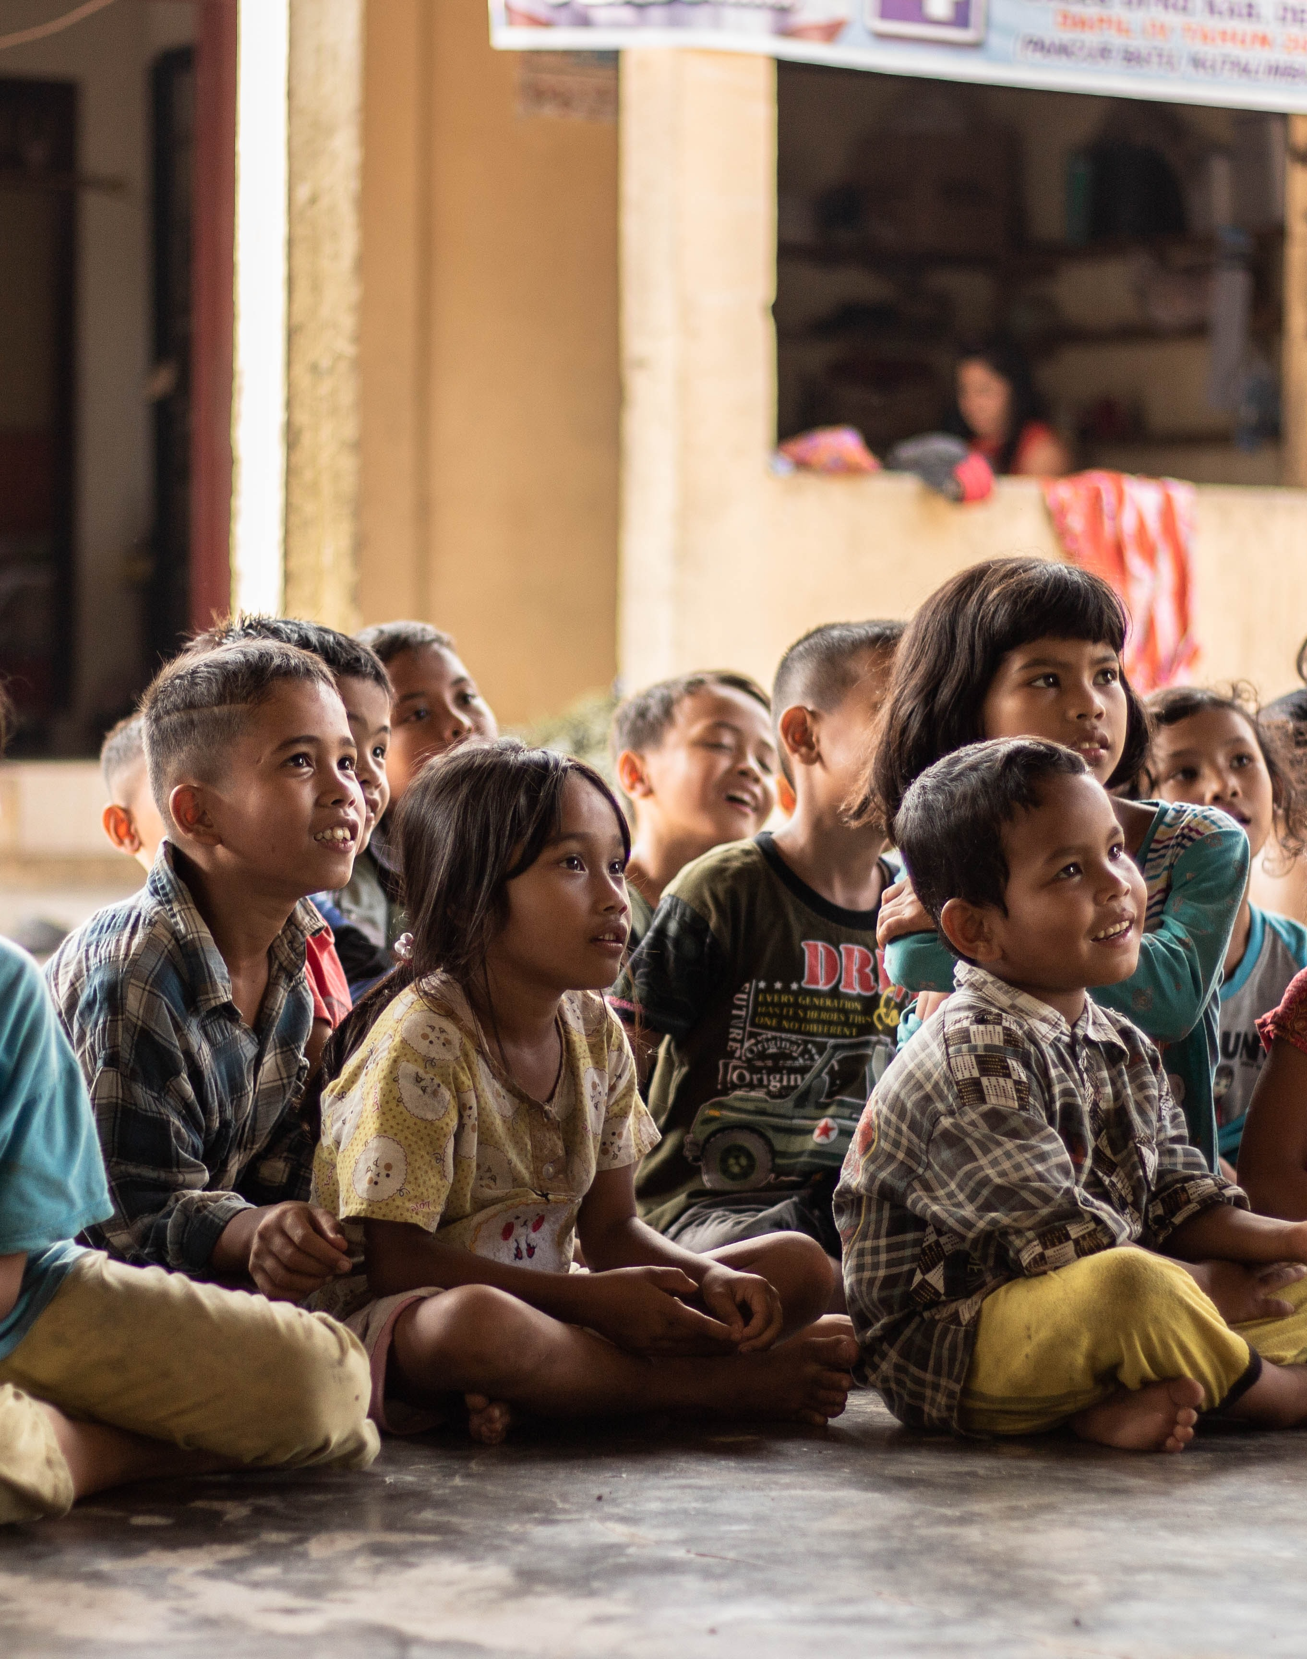
Conclusion and Future Scope
The WeCare website was implemented using extensive UX design process
The future scope of the platform entails implementing the volunteer and blog functions for the website.
The sign up and login functionality could also be implemented in future.
The Kids dream board can also be implemented for the future scope

